Slide 1
Managing Product Delivery

Slide 2
Managing Product Delivery
PRINCE2® manual page 185
Workbook page 257

Slide 3
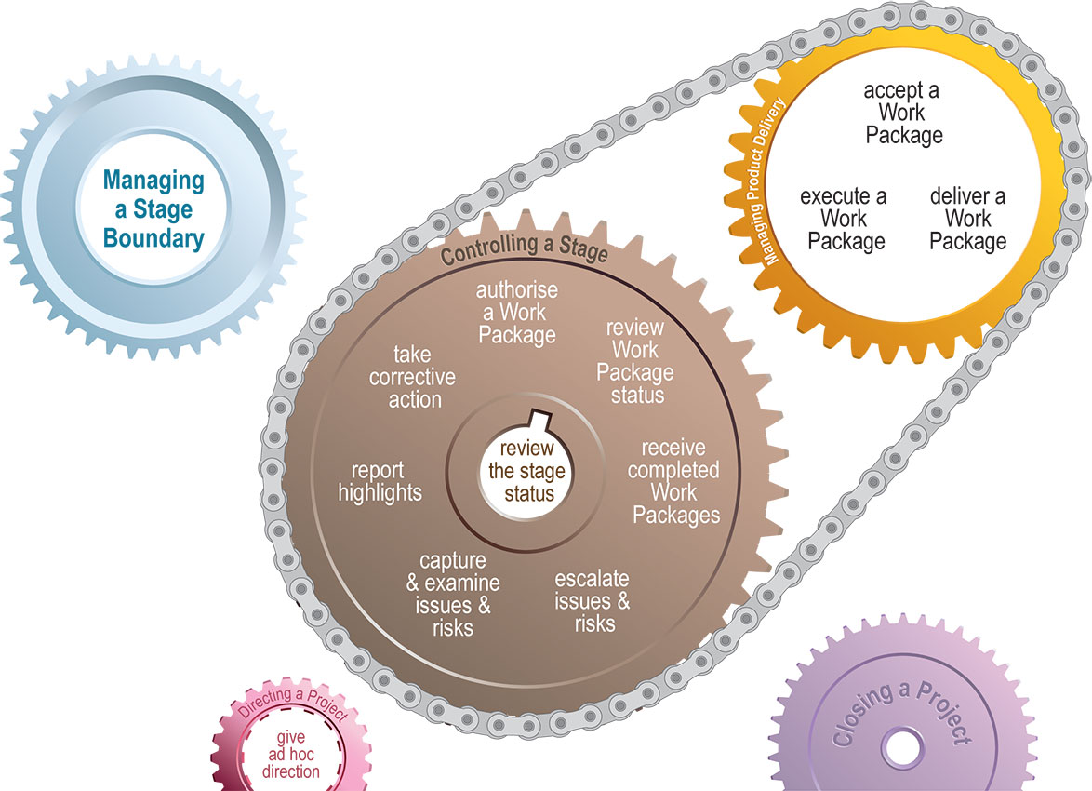
Managing Product Delivery
Process

Slide 4
Managing Product Delivery
Introduction
Works alongside Controlling a Stage
Major deliverable is the completed Work Package
Interface between Team Manager & Project Manager

Slide 5

Managing Product Delivery
Activities
Accept a Work Package
  Agreement with Project Manager about what is to be delivered, reporting requirements, constraints and procedures to apply
Execute a Work Package
  Work within Work Package tolerances
  Raise issues when tolerances threatened

Slide 6
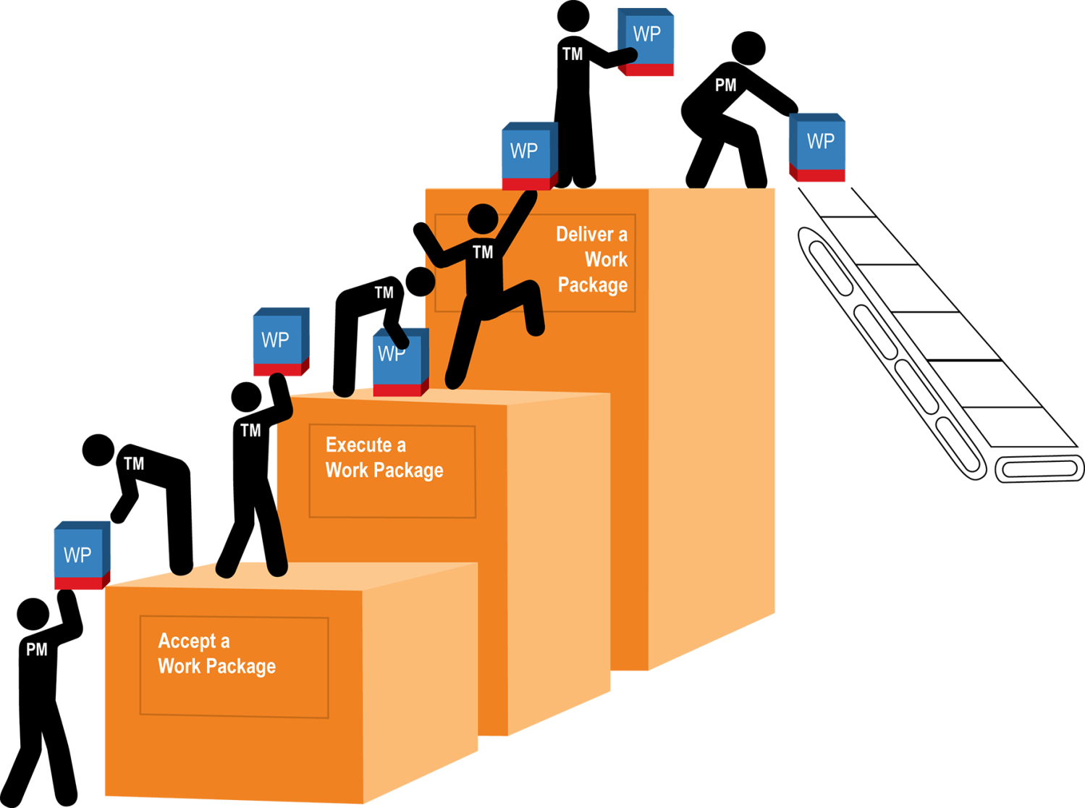
Managing Product Delivery
Activities
Deliver a Work Package
  Once the Work Package is completed
  notify the Project Manager
  There should be: no outstanding
  issues in Quality Register, products
  are 'approved' in the Configuration
  Item Records

Slide 7
Managing Product Delivery
Principles
Continued business justification
Learn from experience
Defined roles and responsibilities
Manage by stages
Manage by exception
Focus on products
Tailor to suit project environment

